Slide 1

Flag football Performance & Injury Anlaytics Platform
Mariam Adegbindin
MS-CISBA capstone

Slide 2

Why this matters
Problem Statement: Casual flag football players juggle busy schedules and limited access to performance science, yet still want to stay safe and improve.
Gap: Most sports-tracking tools focus on mainstream sports or require expensive wearables
A lightweight, player-centered analytics platform that combines easy data entry, clear visual feedback, and basic protections for personal health data

Slide 3
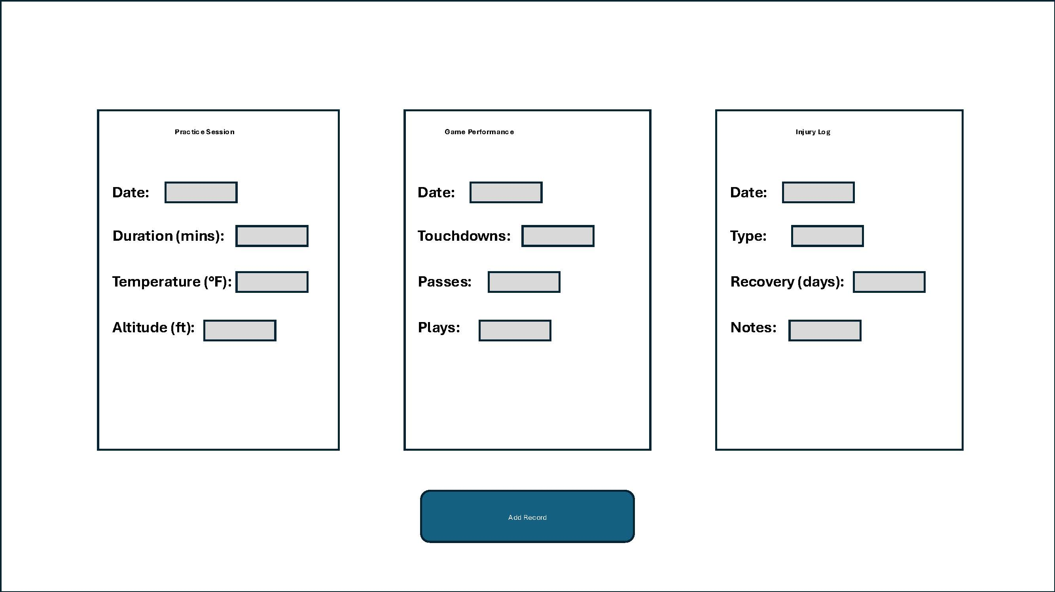

Building the system
Simple, intuitive interface for non-technical users
Three-panel design: Practice Session, Game Performance, and Injury Log
Designed for easy data entry and clear visual feedback
Scalable architecture for future mobile/web implementation

Slide 4
Turning data into decisions
Weekly performance tracking identifies patterns and trends
Correlation between practice conditions and injury risk
Personalized recommendations based on performance data

Slide 5
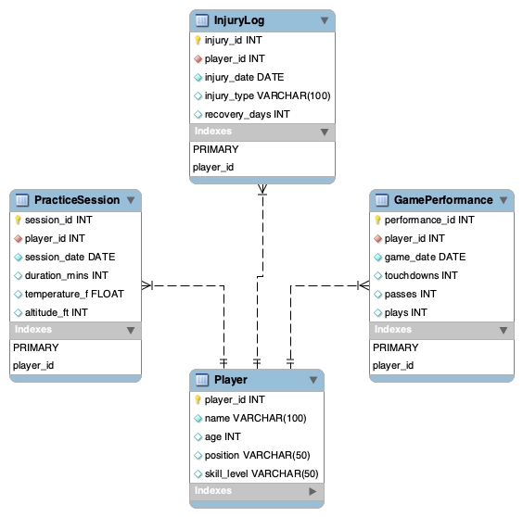
STRUCTURED DATA ARCHITECTURE
Entity-Relationship model with four key entities: Player (who's playing)
PracticeSession (when they practice, conditions)
Game Performance (scoring and play stats)
InjuryLog (what went wrong, recovery time)
Relational schema with foreign key constraints
Designed for data integrity and future scalability

Slide 6
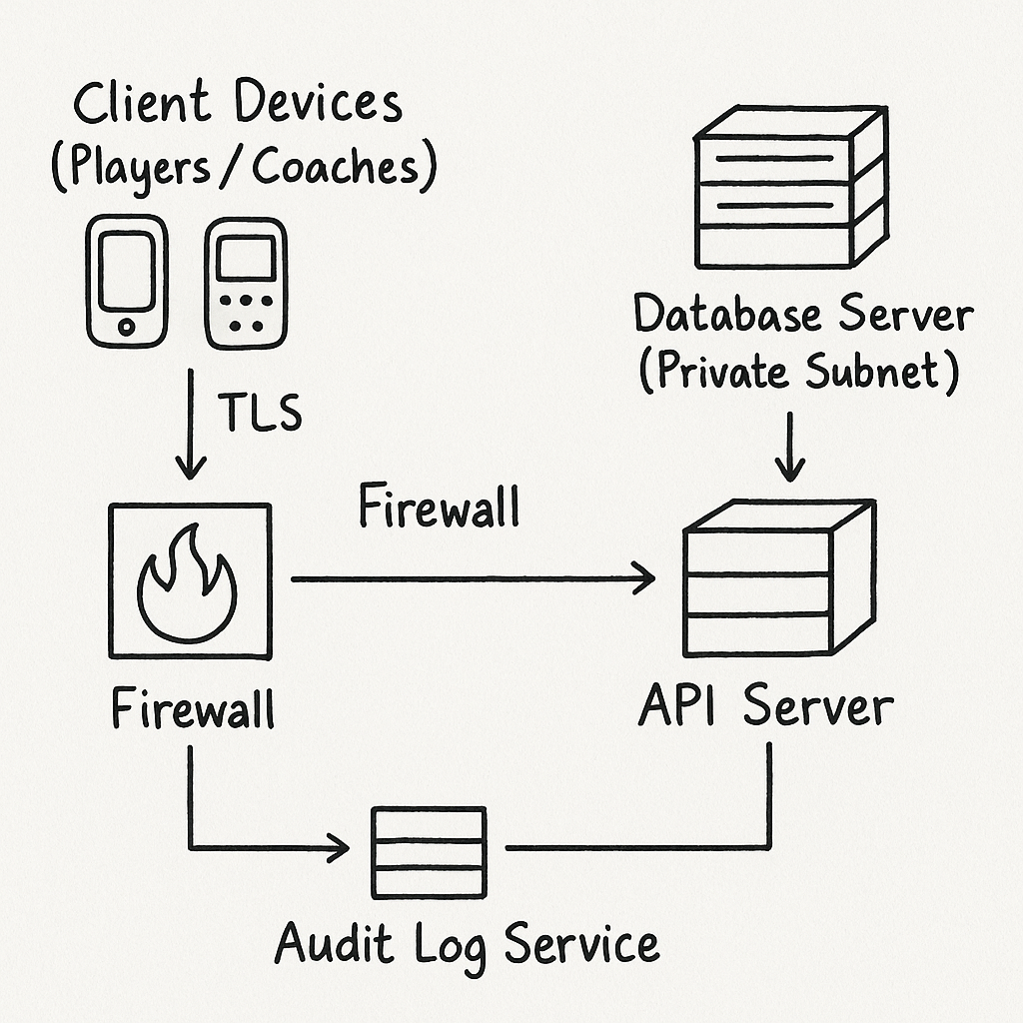
PROTECTING PLAYER DATA
Health and Injury data requires careful protection
Implementation includes
Role-based access control
TLS encryption for all connections
Network segmentation with DMZ
Comprehensive audit logging

Slide 7
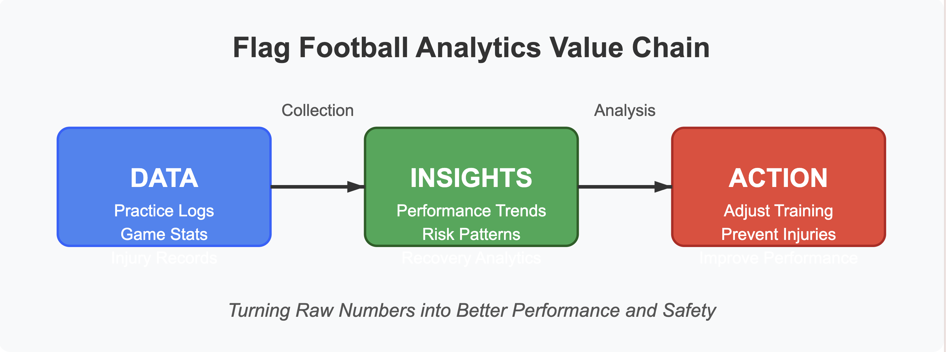
REAL WORLD BENEFITS
Player Level: Optimize practice, prevent injuries, track improvement
Team Level: Identify successful strategies, manage player workload
League Level: Aggregate anonymous data for safety recommendations

Slide 8
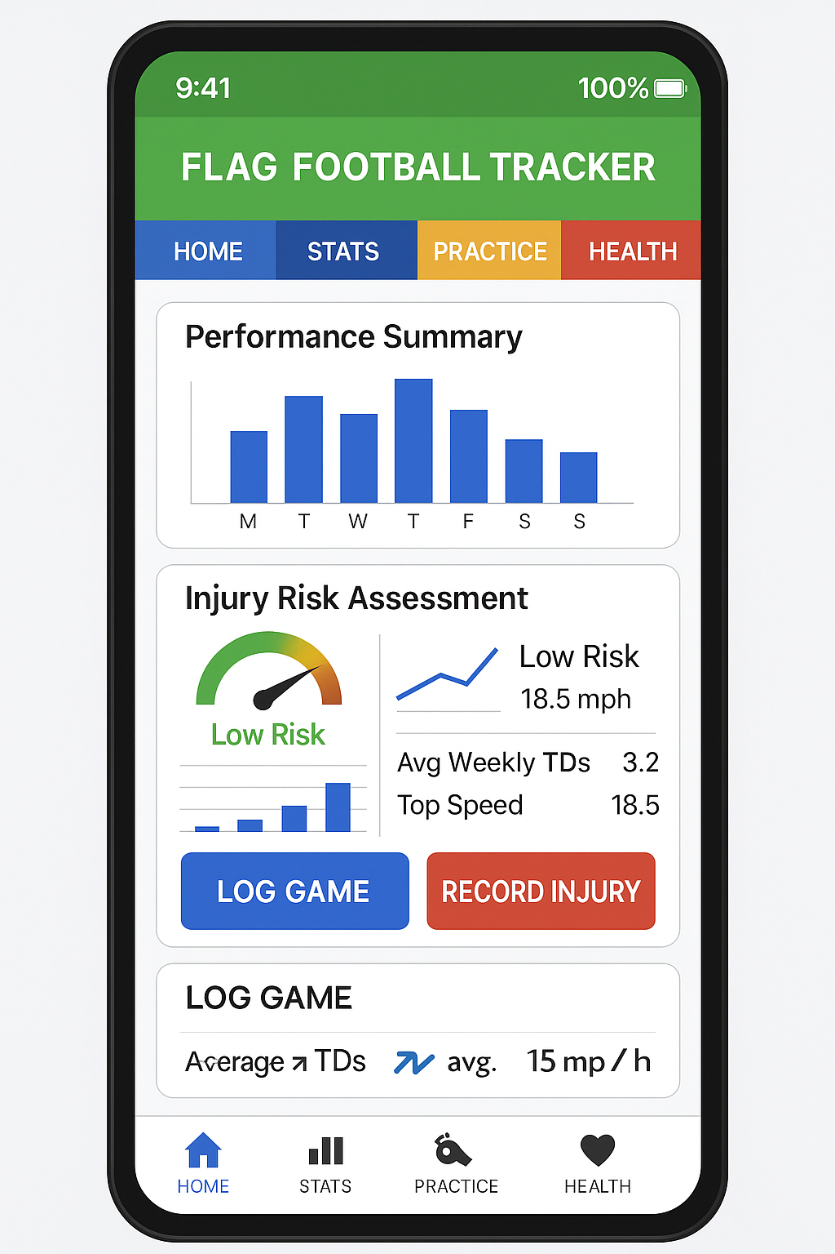
Where this can go
Mobile app with real-time data entry and alerts
Integration with wearable devices for automated tracking
Team and coach dashboards for coordinated training
Machine learning for personalized injury prevention

Slide 9
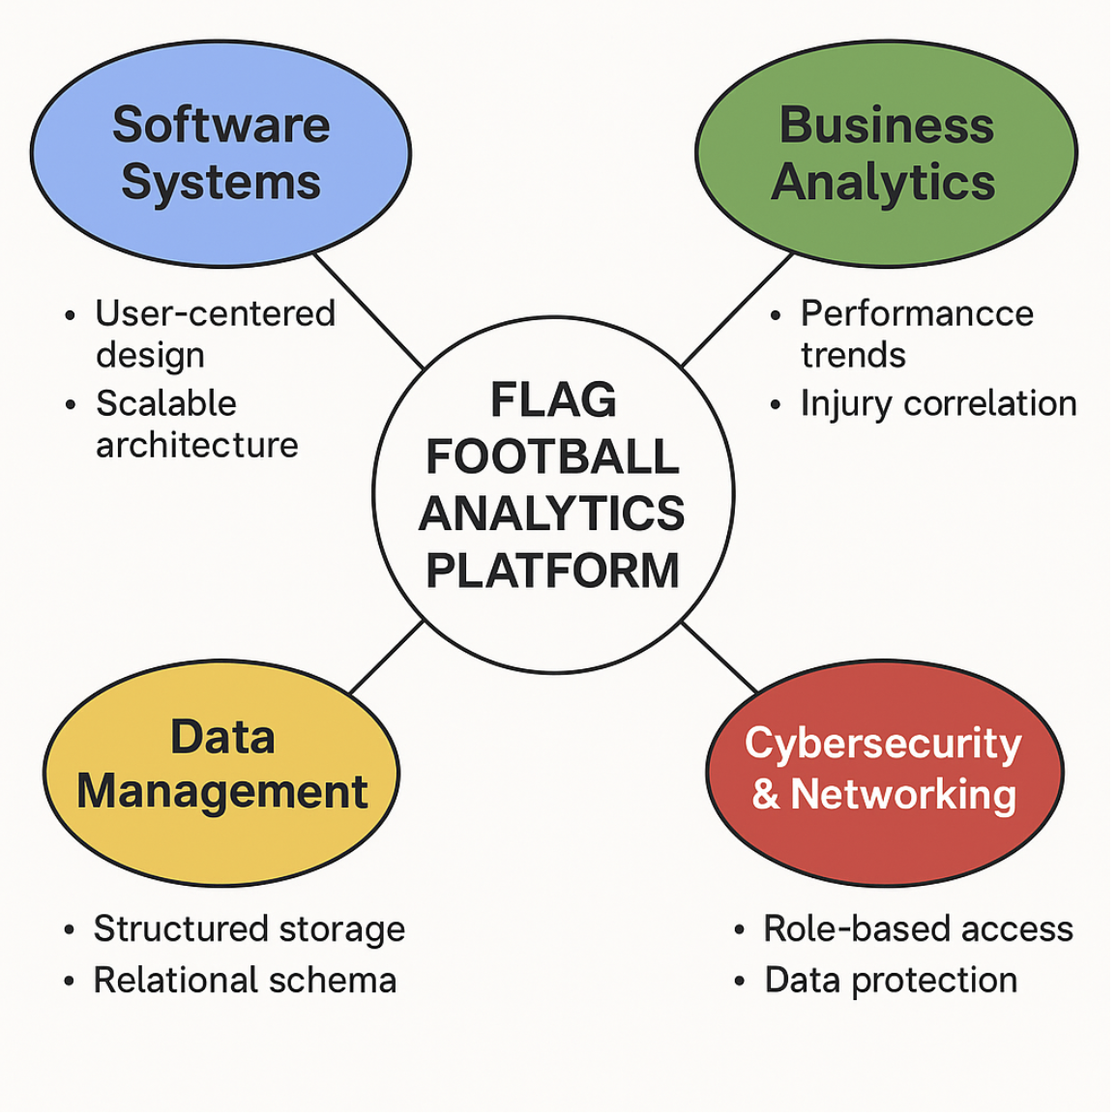
Curriculum synthesis
Software Systems (SS): User-centered design and workflow mapping
Business Analytics (BA): Performance visualization and trend identification
Data Management (DM): Structured schema with referential integrity
Cybersecurity & Networking (CN): Role-based access and network protection

Slide 10

CAPSTONe SYNTHESIS (CONCLUSION)
SS + BA + DM + CN all come together in one cohesive tool
Personal passion fuels practical, data‑driven solutions
Ready for next steps such as refinement, user testing, deployment

